Slide 1


RES-Q
Every Second Counts and Every GPS Matters!

Slide 2

PROBLEM STATEMENT
Rural Accessibility: Ambulance services are scarce in remote and rural areas, hindering accessibility for a significant portion of the population.
Delayed Response: Delays can be life-threatening, especially during emergencies.
Critical Timing: In emergencies, every second counts, making delays especially dangerous.
Logistical Challenges: Distance and lack of proper tools/technologies complicate efficient navigation.
Impact on Health: Improving ambulance availability is crucial for better emergency care.

Slide 3

Optimized way to search location and hospitals
Real-time GPS tracking
Ideation
Shortest path finding
Automatic map bonding

Slide 4
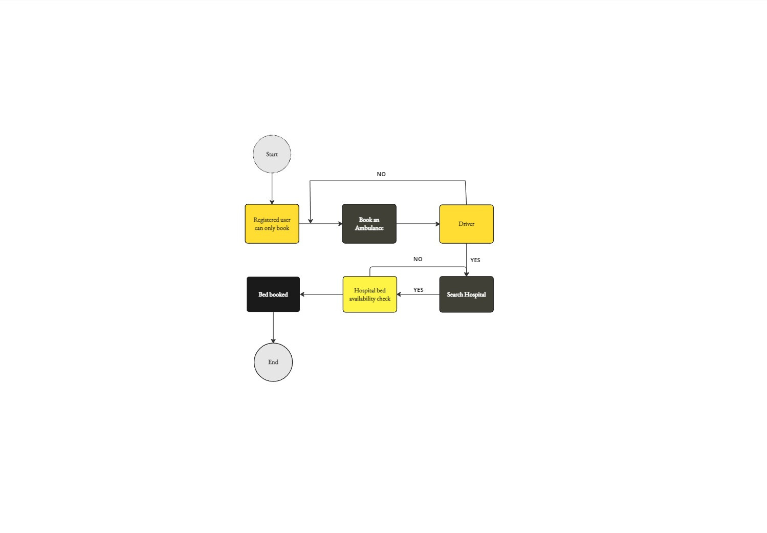
Flowchart

Slide 5
FUTURE PROSPECT
Automatic bed allocation system:
This feature will help patients to get a general bed in the nearest hospital automatically.
Hospital and nursing-home segregation:
This feature will segregate Government hospitals and Nursing-homes to provide patients a large range of option.
Filtering process:
With this feature patient can filter price range for hospital rooms or beds along with ambulances according to patient’s budget range.

